Slide 1

Team Name : emoldinounited
Team Leader Name : Utku Gulbardak
Team Size : 1
Problem Statement : Autonomous multi-signal anomaly detection for manufacturing fleets

Slide 2
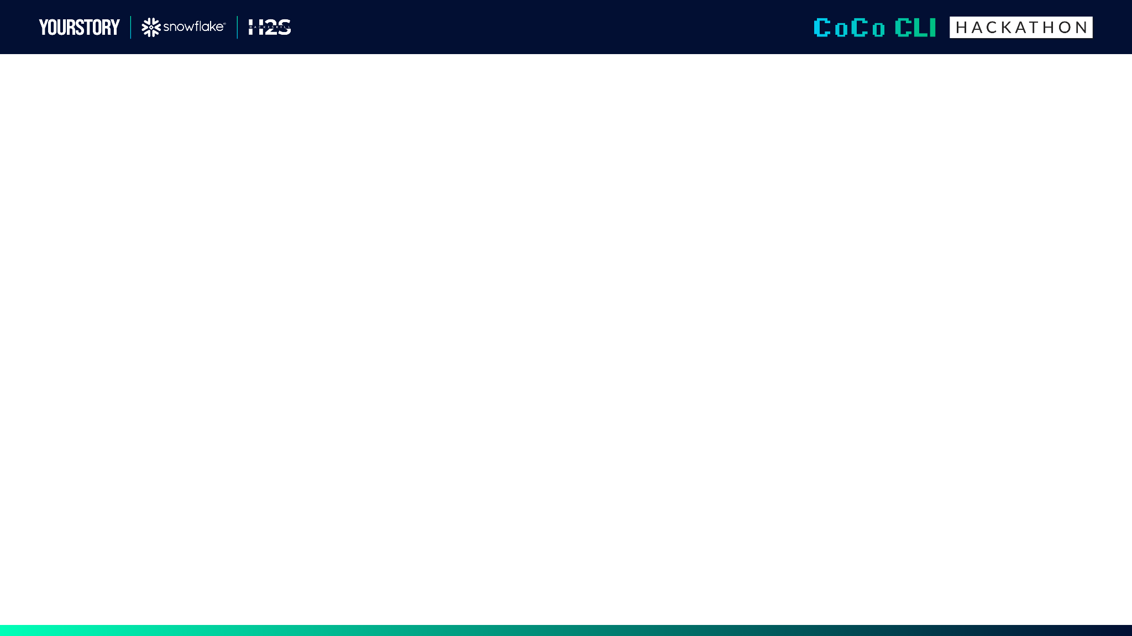
Submission Guidelines: (Things to add on the submission deck)
1. Problem Brief
What real business problem does this solve?
Who is the target user/persona?
What is the current pain point and how does this improve it?
Industry/domain context
2. Architecture Diagram
System design showing data flow
Which Cortex Code CLI skills are used and how they connect
Data sources (structured/unstructured)
How modular components plug together
3. Impact Statement
Measurable outcomes (time saved, accuracy improvement, etc.)
Scalability potential
How this extends beyond the demo

Slide 3
1. Problem Brief
What real business problem does this solve?
Manufacturing lines generate millions of shots per week monitored by single-metric dashboards (cycle time
alerts, stop count thresholds). But the most costly anomalies are multi-signal: a machine drifting 2% per week
looks healthy on any single day, high repair time with normal fault frequency is invisible to stop-count
alerts, and declining week-over-week stability -- the earliest warning -- has no threshold to trigger.
These missed anomalies cause progressive quality loss, unplanned downtime, and scrap that accumulates silently
until a critical failure forces a line stop.
Who is the target user/persona?
Production engineers and plant managers responsible for 10-50 injection moulding machines across multiple
shifts. They lack time to cross-reference 4 separate metric views daily for every machine.
What is the current pain point?
Engineers manually correlate dashboards across CT deviation, run rate efficiency, MTBF/MTTR, and stability
trends. This takes 30-60 minutes per machine and is done reactively after a failure -- not proactively across
the fleet.
How does this improve it?
The agent runs headlessly on a trigger, sweeps the entire fleet in seconds, reasons across all four signal
families simultaneously, autonomously investigates anomalies it finds, and records an auditable decision trail
-- with zero human intervention.
Industry/domain context:
Injection moulding and die casting manufacturing. 8 machines, 243,000 shots over 6 weeks, synthetic but
structurally identical to production data.

Slide 4
2. Architecture Diagram
Autonomous Sense-Reason-Act Loop
[TRIGGER] Schedule or manual command
|
v
[SENSE] CT Deviation + Stability Decline (fleet sweep)
|
v
[REASON] Snowflake Cortex LLM (Claude Sonnet)
- Cross-signal reasoning across detectors
- Decides which machines need investigation
- Selects follow-up tools dynamically
|
v
[ACT] Root Cause Analysis, Save Insights, Generate Reports
|
v
[RECORD] Decision Trail + Self-grade against ground truth
CoCo CLI Skills:
$sense-equipment-anomalies - Fleet sweep (CT deviation + stability)
$investigate-shift-notes - Operator/maintenance context retrieval
$report-and-act - Decision recording and self-grading
Data Source: MMS_DEMO.PUBLIC.DEMO_SHOTS (Snowflake) - 243K rows, 8 machines
Snowflake Services: Cortex REST Messages API (Claude Sonnet, tools),
Snowflake Tables (DEMO_SHOTS, MOLD, SHIFT_NOTE, WORK_ORDER),
PAT Authentication, Synthetic data pipeline with planted defects.

Slide 5
3. Impact Statement
Measurable Outcomes:
- Fleet sweep: under 60 seconds vs 30-60 minutes manual per machine
- Catches anomalies that threshold monitors provably miss
- Demo: MX-7103 drifts 24% with no single-metric alert firing
- Zero false negatives on 4 planted defect types
- Self-grading: verifiable accuracy, not anecdotal claims
Scalability Potential:
- Works on any fleet size (per-machine sweep, parallelizable)
- Detector modules are pluggable (add vibration, temperature, energy)
- Same architecture applies to: finance fraud, supply chain disruption,
predictive maintenance -- any domain with multi-signal anomalies
How This Extends Beyond the Demo:
- Snowflake Task trigger for hourly/daily autonomous runs
- Notification channels (email, Slack) for actionable alerts
- Cortex Analyst for natural-language querying of the decision trail
- Train on historical trails to improve domain reasoning over time
End-to-End Demo (4 entry points):
1. Autonomous headless run: python scripts/run_agent.py
2. CoCo CLI interactive: $sense-equipment-anomalies / $investigate / $report-and-act
3. Streamlit UI: streamlit run demo/app.py
4. Test suite: 716 tests passing (684 app + 40 generator)

Slide 6
